Slide 1
Capstone Project
The Battle of Neighborhoods

Slide 2
Introduction & Business Problem :
The main topic is to put on work a sushi restaurant that will be located in Santiago, Chile. This project contemplate the investigate where is the best location to install a shop like that
Business problem:
located the restaurant in a place where the target audience could easily go and in the possible be the only sushi local in the area.

Slide 3
Target Audience:
To open a sushi restaurant, we'll use the Foursquare information on the communes or localities of Santiago (Chile). For this we define our target audience:
Schools
Universities
Offices
This scope is defined to have the highest public captation and the proximity of other stores offering the same or similar products will be taken into account

Slide 4
Success Criteria:
The success criteria of the project will be a good recommendation of borough/Neighborhood choice based on the differentiation of such restaurants in that location and nearest suppliers of ingredients.
Data:
To find the best location for our sushi place, we will use the following sources of information:
From Wikipedia (tables):
Locations: https://es.wikipedia.org/wiki/Anexo:Comunas_de_Chile_por_poblaci%C3%B3n
PostCodes- https://es.wikipedia.org/wiki/Anexo:C%C3%B3digos_postales_de_Chile
From Files:
Geo Location: https://raw.githubusercontent.com/ssikam/My-Capstone-Project/master/chile%20geo%20public.csv
From Foursquare:
Venues Categories: https://developer.foursquare.com/docs/resources/categories

Slide 5
Methodology
He collected different sources of information such as locations, zip codes, geographic locations to import all this data into a Jupyter notebook.
The selection was based solely on the place of the restaurant or locations in Santiago, Chile, to filter the results that we use the "Metropolitan of Santiago" leaving a total of 52 locations, joined all bases, leaving a size of (52.4).
Information about sushi restaurants, schools, universities and offices was sought for each location obtain this information from Foursquare.
For each location we group and count each of the 4 categories, defined a weight for each category, depending on the recurrence you may have in our sushi restaurant, like:
Sushi restaurant: -1 points (the more restaurants there are in a sector, the less important it’s to us)
Schools: 1 point (they are good clients, but it depends on the money their parents give them)
Universities: 2 points (they are good clients and with more economic independence than the students)
Offices: 3 points (they have their own income and could be frequent clients)
For each location we calculate a final score and order the resulting data from highest to lowest. The place with the highest score will be where we will put our sushi bar.

Slide 6


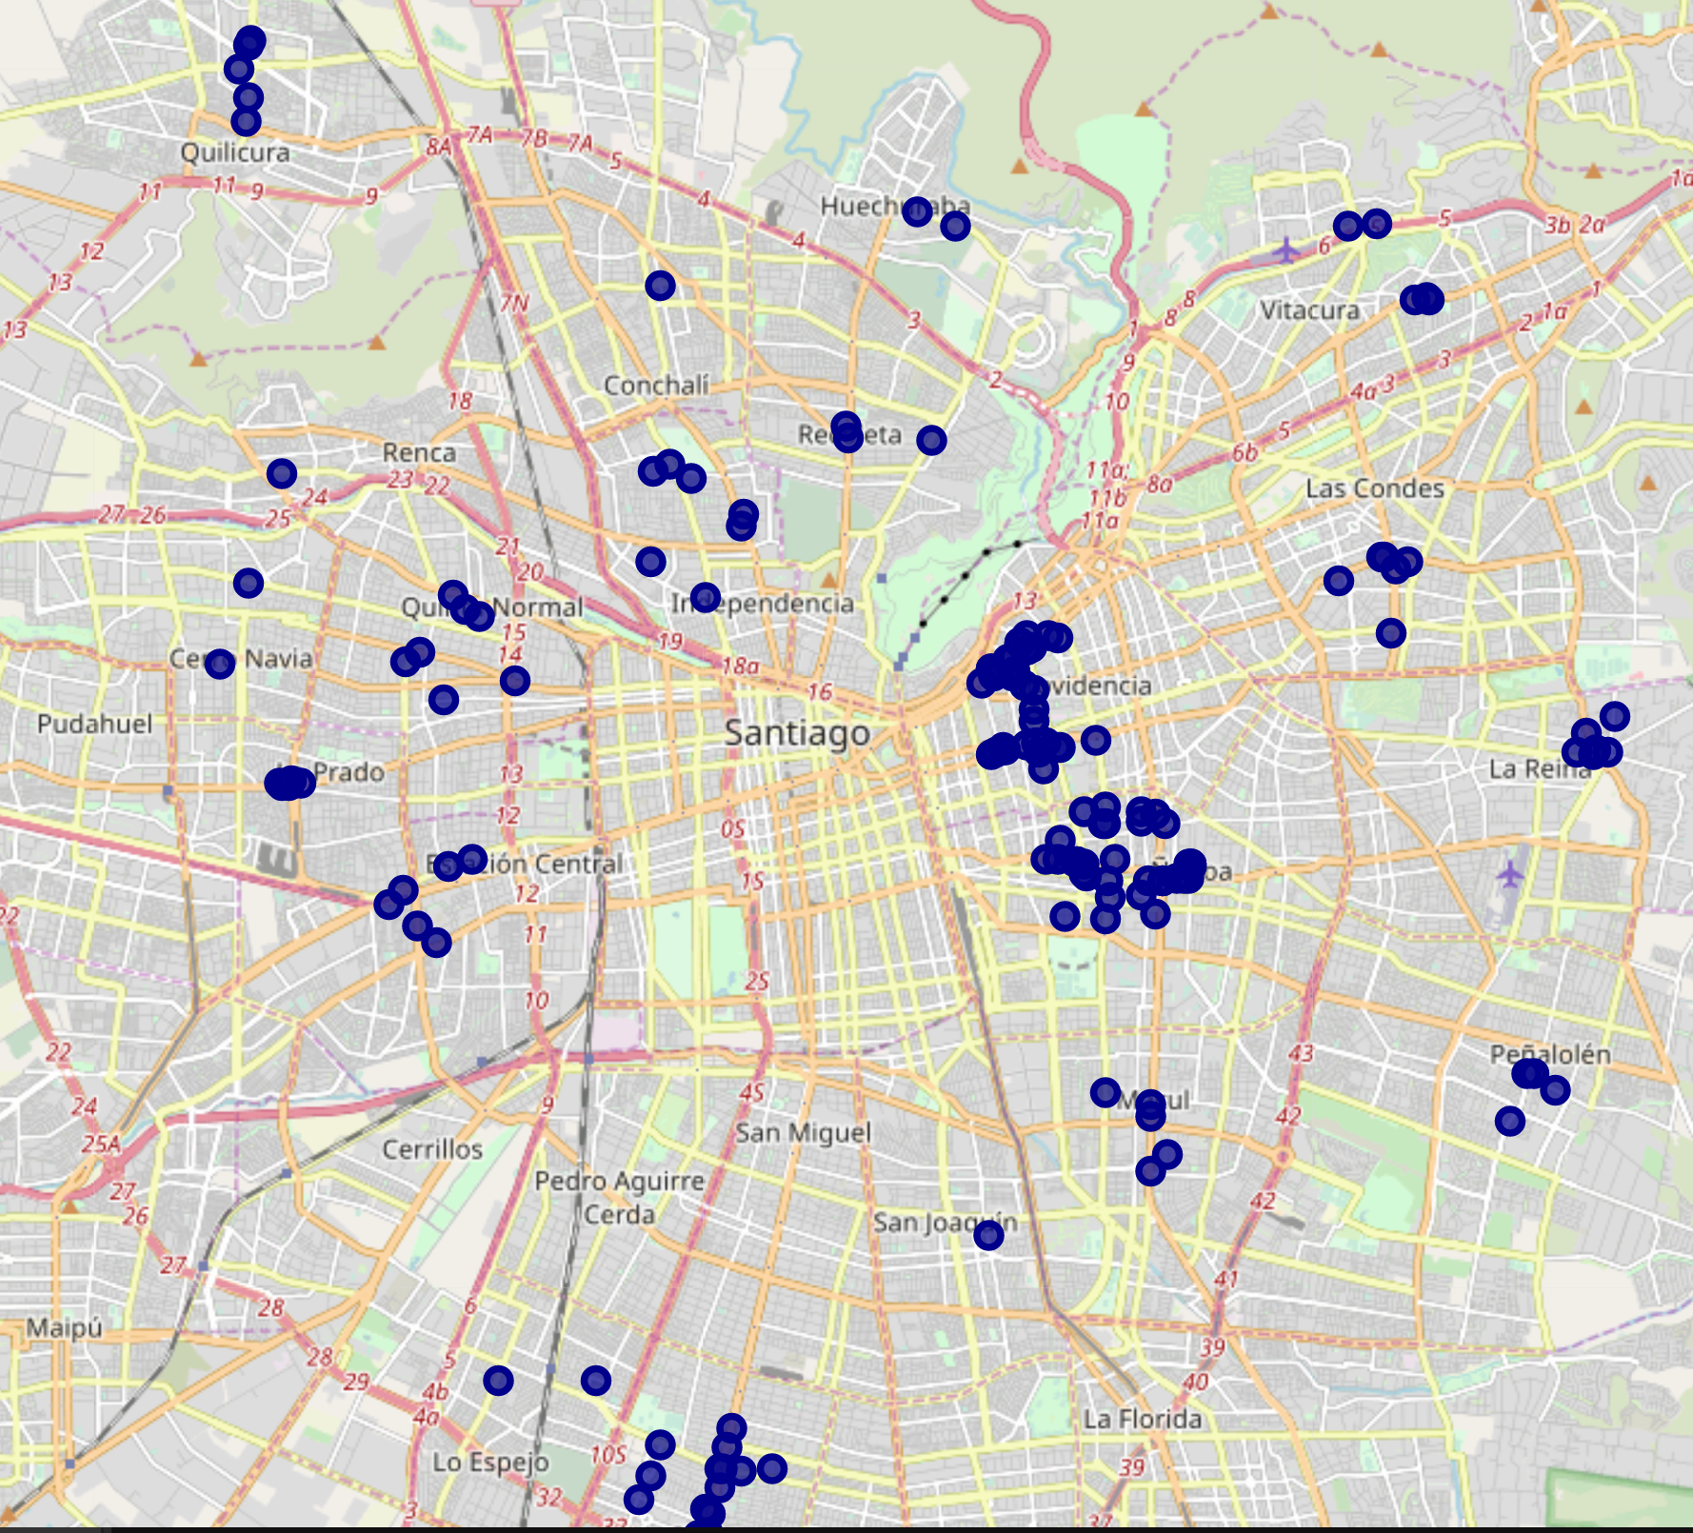
Results
Santiago have 184 Sushi Restaurants indicated with the dark blue dot.

Slide 7
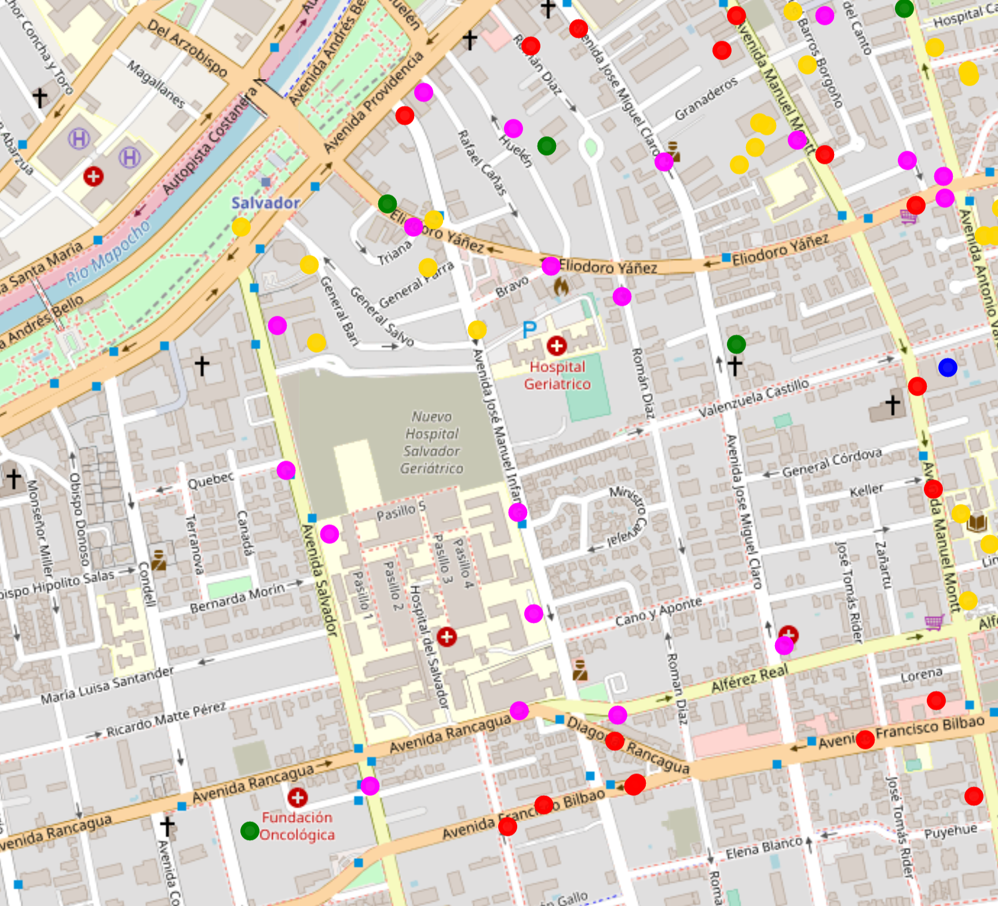
Results
In the image we can see that the suitable place to install a sushi restaurant is indicated with a blue dot, The locality with best score is “Providencia” with 231 pts.
The red dots are the other sushi restaurant, the yellow represent the universities, high school with the green and the office with the fuchsia dot

Slide 8
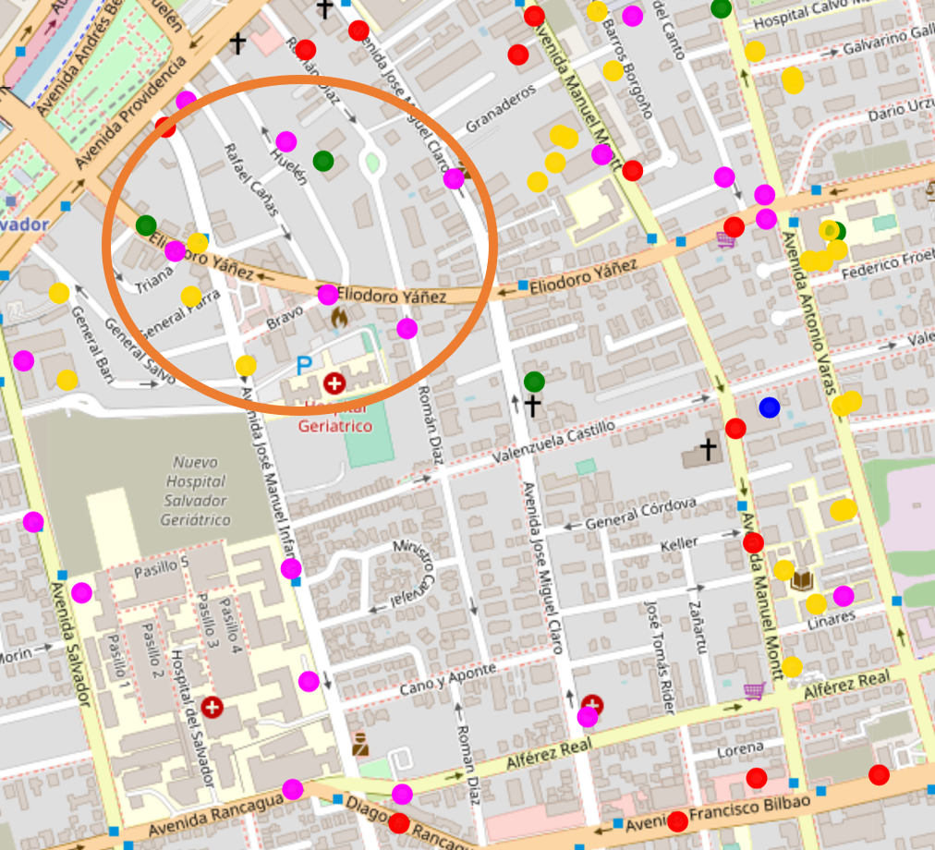
Discussion
As we can discuss, how about we allocated the restaurant in the orange circle?, there are more office and universities as well as high schools, 3 of the target market, we can captive more clients, how about in the nights?.

